Slide 1
ME-291
Classification of Audio From Classical Music Instruments using ML
Members:
ARJUN SINGH
ARYAN AGRAWAL
G.V. RITESH RAMAN
ARIN NARESH
SHREYA T. SANGMA
Supervised by:
PROF. RAJESH KUMAR

Slide 2
PROJECT – WHAT
In this project ,we aim to classify the audio from classical music instruments using machine learning based on the instrument and the emotion.
The process of examining and classifying audio data in order to make it recognizable and searchable is known as Audio Classification .
In this instance , machine learning is used to categorize sounds from musical instruments and the emotions they present.
This entails teaching models to identify and distinguish between different instrument sounds .By using sophisticated algorithms and procedure ,it is feasible to precisely identify the distinctive characteristics of various musical instruments.

Slide 3
PROJECT – WHY
Traditionally, instrument classification relied on human expertise involving manual methods that comprised of human perception and expertise.
This manual approach relied heavily on human perception, musical expertise, and extensive training, making it subjective, time-consuming, and limited in scalability.
ML models can scale to handle large datasets and diverse instrument types with varying playing styles.
ML models can adapt to new instruments or stylistic variations without manual reprogramming.
Hence, we can achieve superior accuracy by learning complex patterns in audio data using ML.

Slide 4
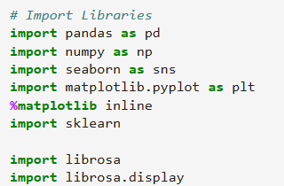
Python Libraries Used
As seen in the snippet libraries like matplotlib, pandas, Numpy , seaborn , Librosa are used for the model.
Librosa is the library for audio and music analysis in Python, specializing in tasks like loading audio files, extracting features (e.g., spectrograms, Mel-frequency cepstral coefficients), and performing audio processing operations.
Other Libraries are used for data visualization.

Slide 5
Models used
We will train the following models for more accuracy-Logistical regression, Naive Bayes, KNN, Stochastic Gradient Descent, Support Vector Machine, Decision Trees , Random Forest ,Neural Networks and XGBoost.
Cross Validation was applied to all models and best parameters were determined with model tuning.
Scikit-learn library of Python is used to deploy all these models.

Slide 6
Models used Justification
Naive Bayes:
Interpretability: Provides easy-to-understand interpretations of feature-target relationships.
Efficiency: It is computationally efficient and suitable for large datasets.
Baseline Model: Serves as a quick and simple benchmark for comparing more complex algorithms
KNN (K-Nearest Neighbors):
Interpretability: Offers straightforward understanding of how neighbors influence classification decisions.
Efficiency: Simple and fast training process; suitable for smaller datasets.
Baseline Model: Provides a basic model for comparison against more sophisticated algorithms.

Slide 7
Models used Justification
Gradient Descent :
Efficiency: Efficiently updates model parameters using small batches of data, making it suitable for large datasets.
Scalability: Scales well to datasets with high-dimensional features or a large number of samples.
Flexibility: Allows for fine-tuning of hyperparameters and optimization strategies to adapt to different learning tasks.
Decision Trees:
Interpretability: Provides easily interpretable decision rules for understanding feature importance.
Efficiency: Fast training process even with large datasets due to parallelizable nature.
Versatility: Handles both numerical and categorical data without requiring feature scaling.

Slide 8
Models used Justification
Random Forest:
Accuracy: Offers high predictive accuracy by aggregating predictions from multiple decision trees.
Robustness: Resistant to overfitting and noise, making it suitable for diverse datasets
Feature Importance: Provides insights into feature importance for understanding model behavior.
Support Vector Machine:
SVM Versatility: Effective for both linear and non-linear classification tasks through kernel functions.
Robustness: Resistant to overfitting and works well with high-dimensional data.
Global Optimization: Finds the optimal decision boundary by maximizing the margin between classes..

Slide 9
Models used Justification
Logistic Regression:
Interpretability: Provides straightforward interpretation of feature coefficients for understanding relationships.
Efficiency: Fast training and prediction times, making it suitable for large datasets.
Probabilistic Outputs: Outputs probabilities for binary classification tasks, enabling uncertainty estimation.
Neural Networks:
Complex Patterns: Learns complex patterns in data with multiple hidden layers.
Adaptability: Adapts to various types of data and tasks through different architectures and activation functions.
State-of-the-Art Performance: Achieves state-of-the-art performance in many domains, including image and speech recognition.

Slide 10
Models used Justification
XG Boost:
Versatility: Effective for both classification and regression tasks, with support for custom loss functions and evaluation metrics.
Robustness: Resistant to overfitting and capable of handling missing data through built-in regularization techniques.
Performance: Achieves state-of-the-art performance on various machine learning tasks with scalable and efficient implementations.

Slide 11
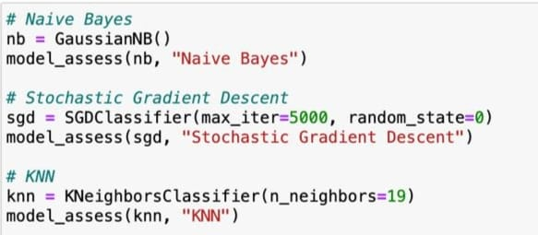
Deployment of Models

Slide 12
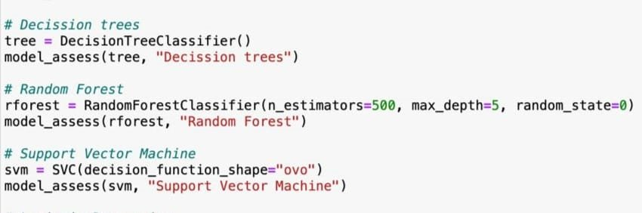
Deployment of Models

Slide 13
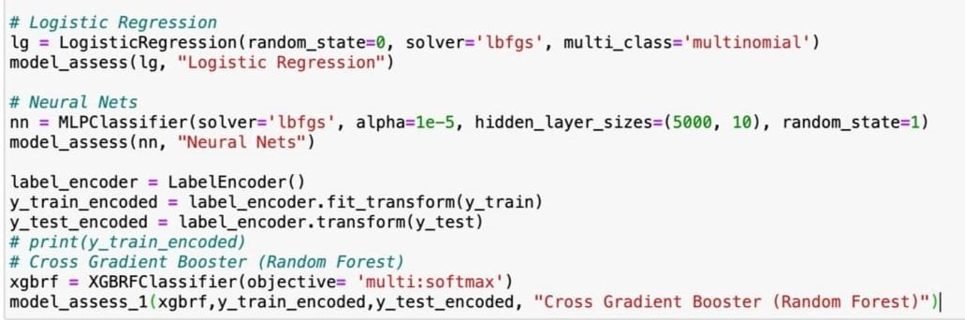
Deployment of Models

Slide 14
Feature Extraction
To extract features, we must break down the audio file into windows, often between 20 and 100
milliseconds. We then extract these features per window and can run a classification
algorithm for example on each window.
1. Statistical Features
A first easy step is to compute the mean, standard deviation, minimum, maximum, median
and quartiles of the frequencies of each signal. This can be done using NumPy and it always
brings value to our feature extraction.
2. Root Mean Square Energy
The RMS Energy (RMSE) is simply the square root of the mean squared amplitude over a time window.
It is defined by:
RMSE(x)=√{(∑∣x(n)∣^2)/N}
3. Zero-Crossing Rate
The zero crossing rate indicates the number of times that a signal crosses the horizontal axis, i.e.
the number of times that the amplitude reaches 0.This will return the total number of times
the amplitude crosses the horizontal axis.

Slide 15
Feature Extraction
4. Tempo
The tempo, measured in Beats Per Minute (BPM) measures the rate of the musical beat.
5. Poly features
The poly features returns the coefficients of fitting an nth-order polynomial to the columns of a spectrogram.
6. Tempo gram
The tempo gram is a feature matrix which indicates the prevalence of certain tempi at each moment in time. Librosa has a built-in function to extract this information. It is common to focus only on the first N rows (e.g. 13) of the matrix.
7.Spectal Features
Spectral features are extracted from the spectrogram. Spectrograms offer a powerful representation of the data. It plots over the time, for a given range of frequencies, the power (dB) of a signal. This allows us to spot periodic patterns over time, and regions of activity.
The most common feature to extract is the spectral centroid.
There are other features that contain information like bandwidth , contrast , flatness , roll off.

Slide 16
Feature Extraction
8. MFCC
Mel-frequency cepstral coefficients (MFCCs) are a set of features commonly used in speech and audio signal processing to represent the characteristics of sound in a way that mimics human auditory perception.
This process enhances the effectiveness of tasks like audio compression and recognition by capturing important characteristics in a compact form. MFCCs are calculated by taking the Fourier transform of audio signals, finding the power spectrum, applying Mel filterbank, mapping them to the mel scale, applying logarithmic transformation, and then computing the discrete cosine transform.
9. Chroma
Chroma features are condensed descriptions of music sound, showing energy levels for each small note change in music. They stay consistent even when music speed or instruments change. This helps in figuring out music styles and identifying chords by looking at how notes relate to each other.

Slide 17
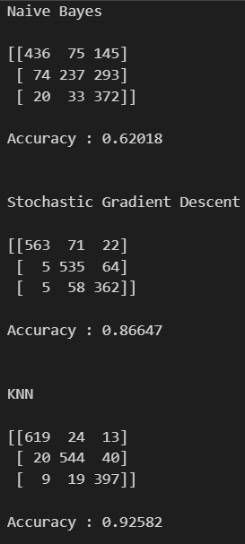
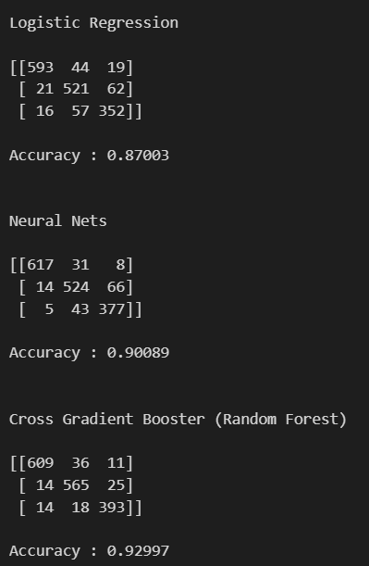
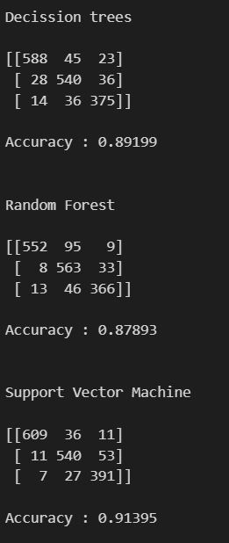
FINAL OUTPUT
INSTRUMENT CLASSIFICATION

Slide 18
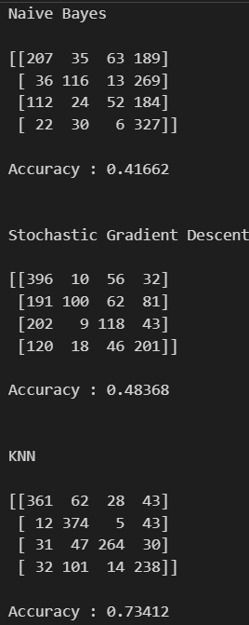
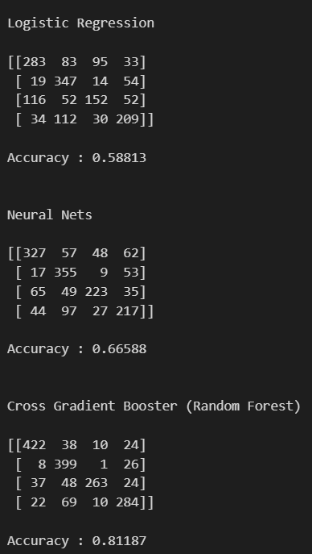
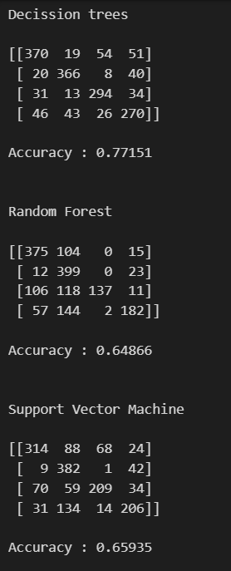
FINAL OUTPUT
EMOTION CLASSIFICATION(4 emotions)

Slide 19
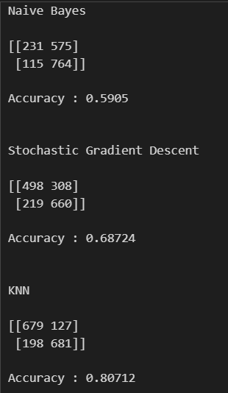
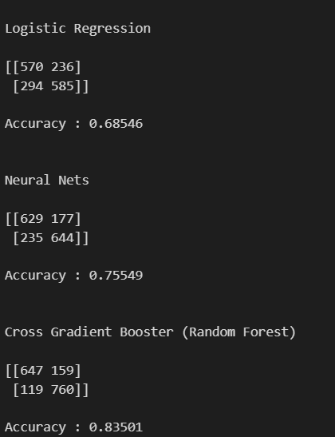
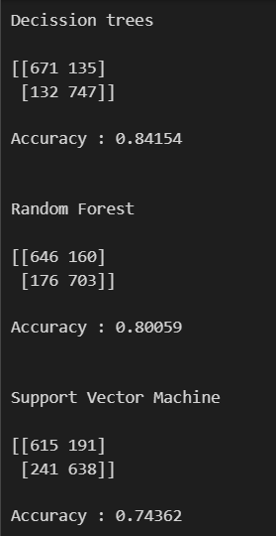
FINAL OUTPUT
EMOTION CLASSIFICATION(2 emotions)

Slide 20
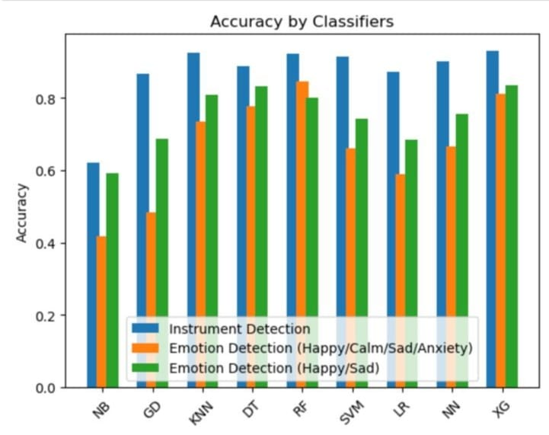
Comparisons of Model
Best result is given by XGBoost.

Slide 21
Challenges in Audio Classification
Variability in Sound Characteristics : The diverse characteristics of musical instruments like timbre , pitch , and volume can vary widely affect the classification.
Presence of Background Noise : The presence of ambient noise can interfere in the feature extracted which will eventually affect the accurate classification of instruments sounds.
Class Imbalance: Imbalance in the distribution of audio samples across different instrument classes can affect the performance of classification models, leading to biased predictions towards the majority classes.
High Dimensionality: Audio data is high-dimensional, especially when considering features like spectrograms or Mel-frequency cepstral coefficients (MFCCs), which can lead to computational complexity and require efficient feature selection techniques.

Slide 22
Conclusion
In conclusion, our project has developed and implemented different machine learning models for determining the instrument type and type of emotion corelating to type of pitch, tempo major or minor tune of the audio. Through data feature extraction, and model training, we have summarized the performance index of different models and found their respective accuracy in completing the task.
The adoption of this ML model holds significant promises for music related apps , offering an innovative approach to classify music systems. It removes the need for a tiresome procedure of listening to each and every audio file and tabulating the data. This also proves to be a less error filled process and gives us clear cut results.

Slide 23
THANK YOU

